Slide 1
So You Want A Truck?
Hunting For Trucks in Texas
Notes:
The used car market is chock full of fascinating data about market trends, consumer purchasing behavior, and a wide variety of other interesting information.
This data can easily be leveraged to find the optimal outcome, sometimes with surprising results.
Let’s see how we can use the power of data to find the best location to source used trucks to sell.

Slide 2
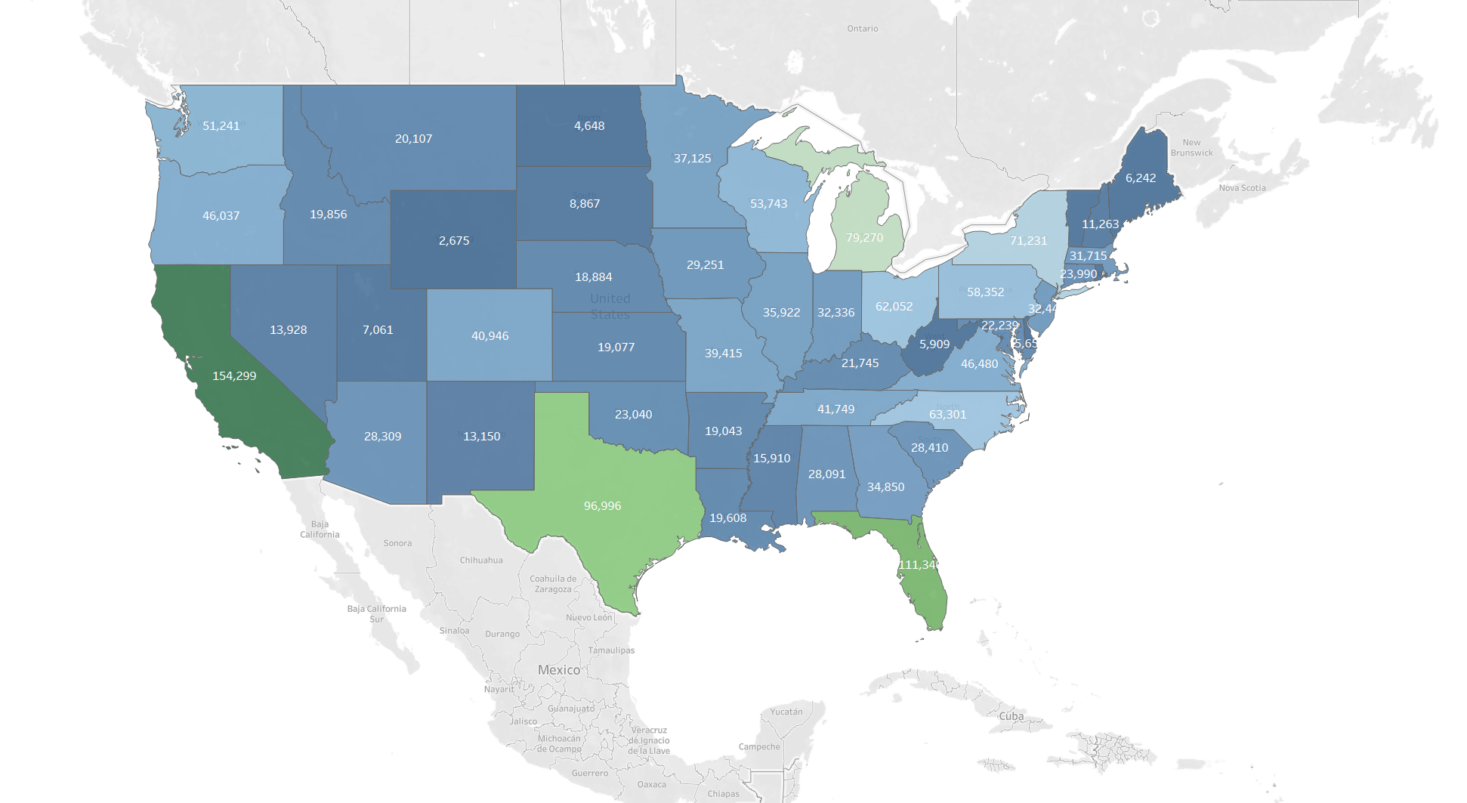
America In Cars
Notes:
Be aware that this only takes into account Craigslist postings, however given the ubiquity of the platform they should provide a serviceable representation of the nation’s auto market. The only downside is that usage of the platform may be lower in some regions, especially more rural ones, which may lead to somewhat skewed data.
Utilizing this data, we can find the best prices on the best condition vehicles in Texas for the lot.
As expected, high population states such as California and Texas dominate the rankings.
Since we’re located in Texas, let’s narrow in on there.

Slide 3

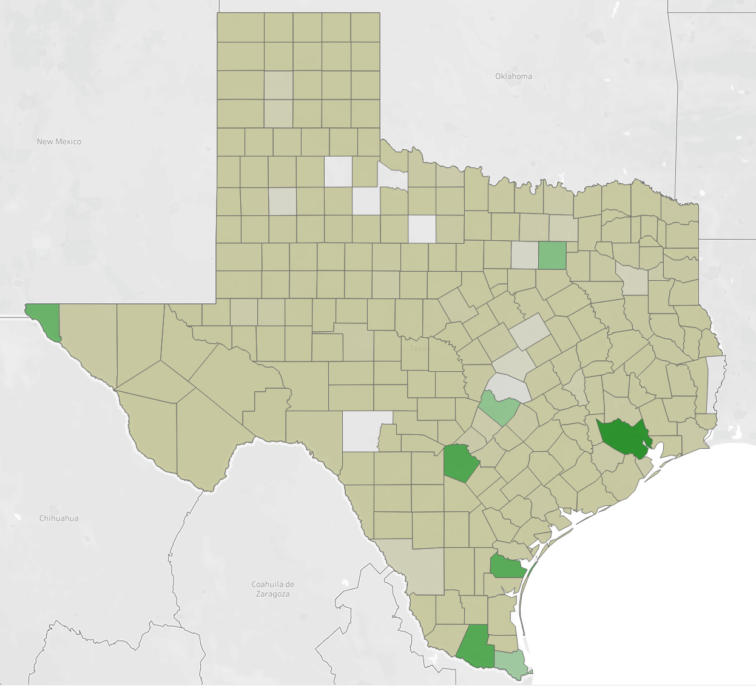
Texas Car Oases
Rather grim options for those stuck in the carless deserts
Pretty much clustered around the major metro areas
Notes:
Unfortunately due to incomplete data and nonexistent usage of the platform in some of the more rural counties the map is not totally filled in (note the handful of blank spaces).
However, it represents all the major markets well (the shade of green is fairly well correlated to population).
We’re located in San Antonio, situated inside the darkest green space in the south-east corner name Harris county.
We’ll start our search there and see what happens.
This county packs over 8000 listings, presumably many of them trucks, so there should be plenty of options.

Slide 4
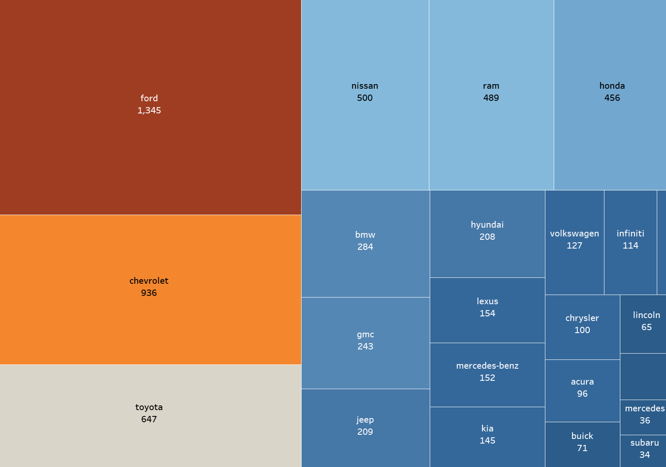
Cars of Harris County
Absolutely dominated by Ford, followed by the other top brands
This is Texas, so let’s narrow it down to American brands
Notes:
Interesting to see how brands such as Hyundai and Kia are so far behind other top foreign manufacturers like Nissan and Toyota. Maybe because they focus solely on passenger cars instead of pickups?
We’ll be able to just how great of an effect these Texas icons have on brand sales soon.

Slide 5
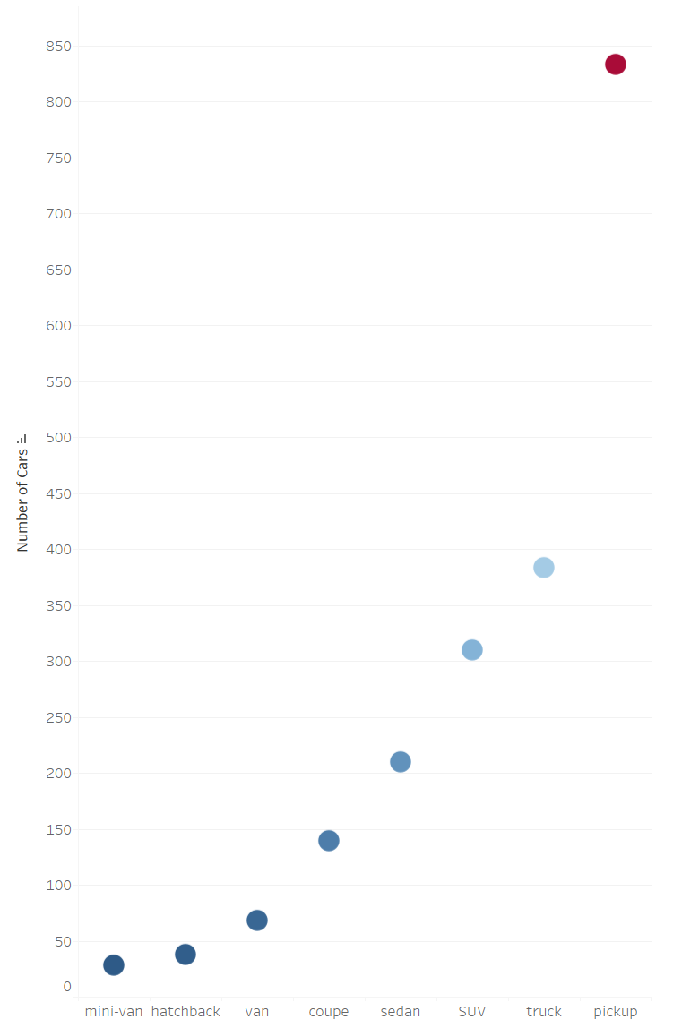
Everything’s Bigger In Texas
Pickups and other big vehicles absolutely dominate
Represent virtually all the American brands’ advantage over the competition
Seems like a great place to find our truck, right?
Notes:
Interesting to see the massive gap between pickups and everything else.
Follows the general American trend towards ever bigger vehicles.
Should offer many options that are highly desirable and marketable in the area.

Slide 6
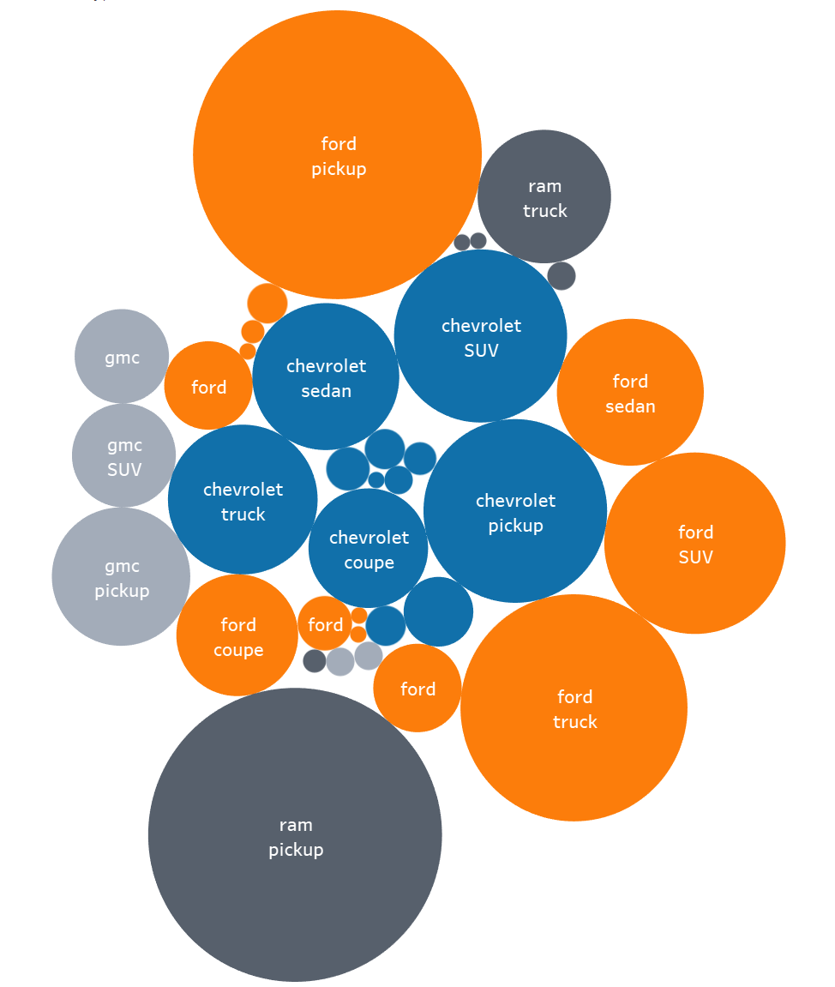
The Necessity of Trucks
Many American manufacturers absolutely depend on trucks in Texas
Sales for everything else pale in comparison
Notes:
Ford is massively biased towards pickups/trucks, Chevrolet much more balanced.
Ford F-Series pickups the top overall seller in the US for many years, so this makes sense.
Note: Ram only sells pickups, so understand those circles accordingly.
Keep this in mind as we purchase vehicles to see which sell best.

Slide 7

Car Buying Priorities
Price?
Color?
Location?
Efficiency?
Condition and wear above all.
Notes:
When people consider buying a car (whether new or used) they typically take a wide variety of factors into consideration.
All of these are often key to the buying process, but I believe that one predominates.
The first thing people see is the condition of the car (paint, seats, etc), and this typically creates a very strong first impression.
This is heavily impacted by how many miles the car has been used for, and so for this analysis we will focus primarily on the average miles driven per year to seek out the vehicles in the best condition inside and out.
This intersection of condition and price should be the best spot for us to buy in.

Slide 8
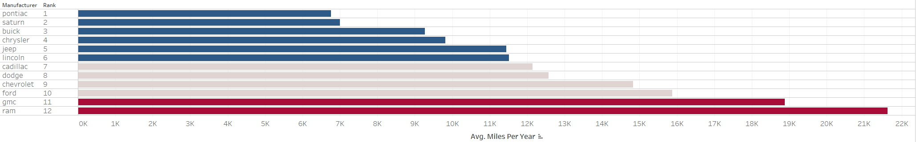
Best Condition Brands
Notice how the big truck brands are clustered at the bottom
Why might this be the case?
Seems a bit concerning for our search
Notes:
All the big truck brands (Ram, GMC, Ford, Dodge, and Chevrolet) are smack at the bottom.
More car focused brands like Saturn and Buick top the chart.
Interesting to see the top two are both companies that haven’t sold a new vehicle since the late 2000s.

Slide 9
Let’s Drill Down A Bit…
For both Chevrolet and Ford trucks rack up enormous miles.
Really hurts the chances of finding a solid vehicle.
So What Now?
Notes:
Could be the result of an overabundance of pickups as commercial vehicles and generally being used much more harshly on a daily basis.
Really makes it hard to recommend looking for trucks to sell in Harris county.
Maybe look elsewhere, say to a neighboring state with a solid market like New Mexico?

Slide 10
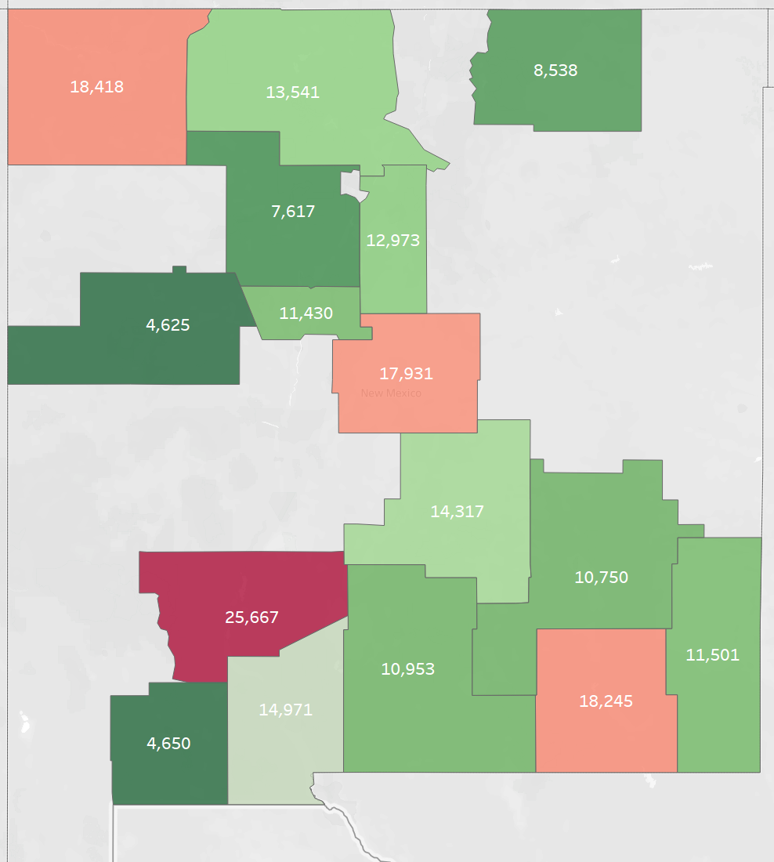
The Greener Pastures of New Mexico
Seems much better than Texas
Average truck mileage in SE corner is very promising
Might be worth the extra shipping?
Notes:
Unfortunately the data is not very complete and has some weird outliers, but what is there gives a pretty good look at what’s available.
Bit of a drive from Harris County, but finding equivalent vehicles with half the miles should be an easy reason to make the trek.

Slide 11
In Conclusion…
Following the data can lead you to weird places
Seems that the best course of action would be to buy in SE New Mexico and ship them to Harris County.
Harris County should represent a ripe market for low mileage trucks given the massive sales in the region and the condition of the vehicles there.

